Slide 1

Heaven’s Light is our Guide Rajshahi University of Engineering & Technology
CSE-2100
SOFTWARE DEVELOPMENT PROJECT 1
CureConnect: Doctor Directory Website Proposal
Submitted by Shuvo Dip Kar Roll: 2203168 Dept. Of CSE | Submitted to Rizoan Toufiq Associate Professor Dept. Of CSE

Slide 2
Introduction to CureConnect
CureConnect is an intelligent healthcare web application designed to simplify the process of finding the right doctor based on a user’s symptoms.
In a country like Bangladesh, where people often struggle to identify which specialist to consult, CureConnect bridges this gap using Natural Language Processing (NLP).
Users can describe their health problems in everyday language, and the system will suggest possible conditions along with relevant doctors manually added for accuracy. This helps users take the first step towards the right medical care without confusion or delays.

Slide 3
Planning For CureConnect
Did you know?
67% of Bangladeshis live in rural areas with limited medical access
Only 0.6 doctors per 1,000 people
78% lack reliable healthcare info
Many people in Bangladesh struggle to find the right doctor due to a lack of centralized information. Patients often rely on word-of-mouth recommendations, which may not always lead to the best medical care. Additionally, misinformation, long waiting times, and the challenge of knowing which specialist to visit can cause delays in treatment. Rural areas, in particular, suffer from a lack of specialist doctors, making healthcare even more difficult to access
CureConnect is here to change that.

Slide 4
How CureConnect Is Solving These Issues
CureConnect simplifies the process of finding the right doctor by using
NLP-based symptom analysis to suggest possible health conditions and
relevant specialists.
🔹 Key Features
Symptom-Based Suggestions: NLP extracts key terms from user input and matches them to possible conditions.
Curated Doctor Listings: Manually added, trusted doctors with their specializations and contact details.
User-Friendly Interface: Clean and responsive design that works well on all devices.
Awareness Sections: Informative content about healthcare access and CureConnect’s mission.

Slide 5
Tools and Technologies For CureConnect
Frontend
HTML, CSS, JavaScript for the user interface.
Frameworks like React.js for a dynamic experience.
Backend
Django for server-side logic.
Database like MongoDB or MySQL for storing doctor and user information.
Dataset and Libraries:
Python Libraries: Pandas, NumPy, Scikit-learn, Matplotlib for data processing, visualization, and machine learning. Hugging Face Transformers and PyTorch for deep learning and model training.
Symptoms to Disease Dataset From Kaggle

Slide 6
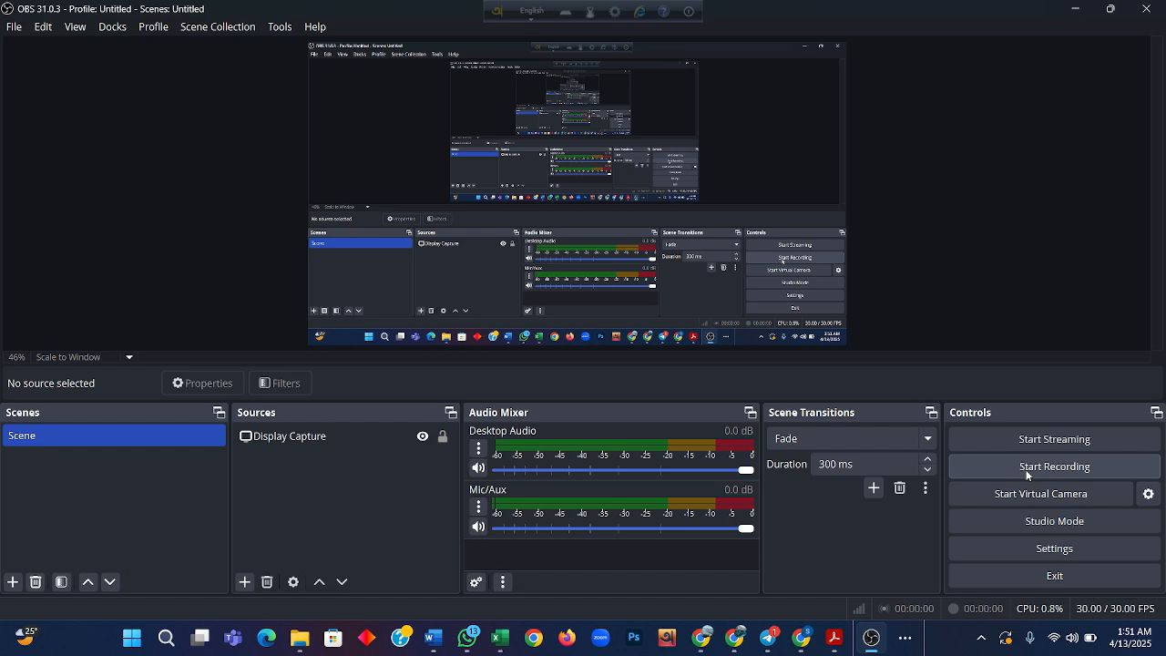
Video Insight For CureConnect

Slide 7
Future Planning For CureConnect
Goal: Revolutionize healthcare accessibility in Bangladesh by providing reliable, easily accessible medical information.
Future Plan: Develop a structured doctor database and integrate AI for more precise health recommendations.
Implement a location-based feature using Google Maps API to help patients find doctors nearby.
Improve model accuracy for better health recommendations.
Launch Mobile App

Slide 8
GitHub Link For CureConnect
The link is given below:
https://github.com/ShuvoDip23/Project_CureConnect

Slide 9
Thank You

